Slide 1


Stroke Prediction Dataset
Kelompok 2
Nabila Mutiara Sifia / 23090230005
Milan Andariana / 23090230009
Lintang Berliana / 23090230013

Slide 2
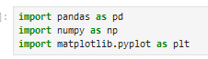
Highlights

Slide 3
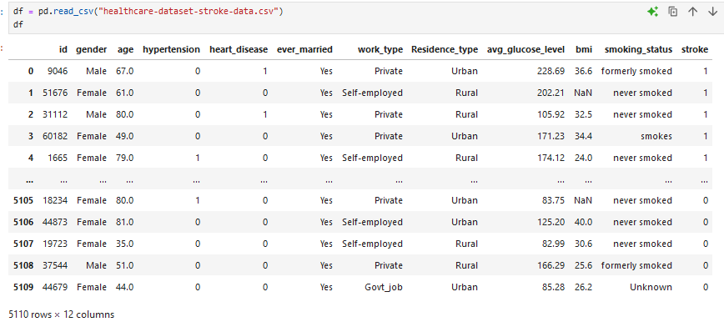

Slide 4
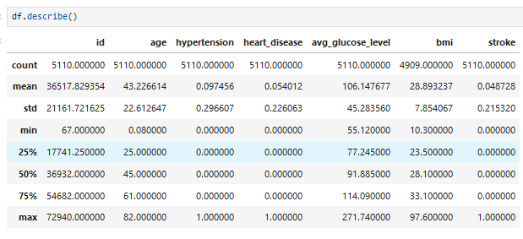

Slide 5
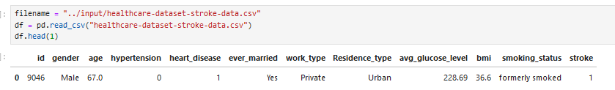

Slide 6
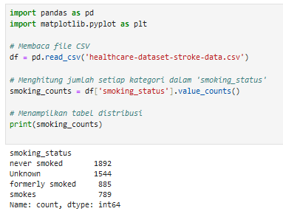

Slide 7
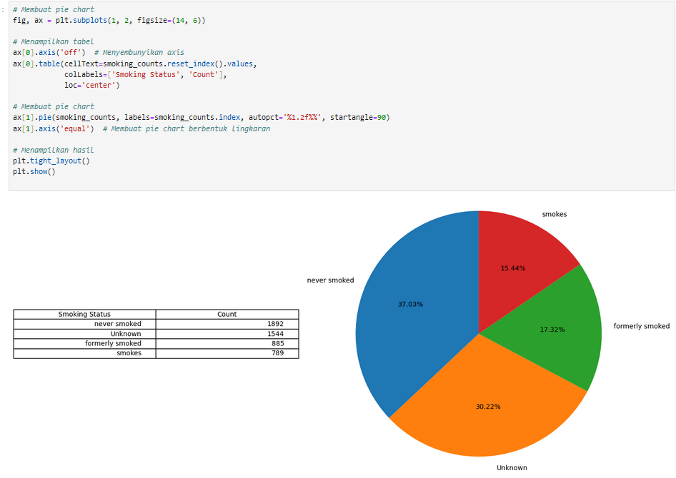

Slide 8
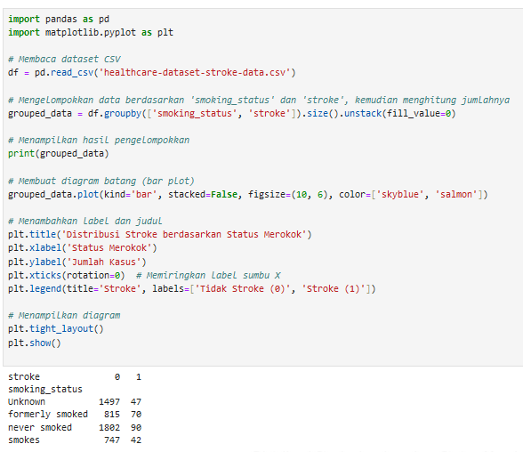
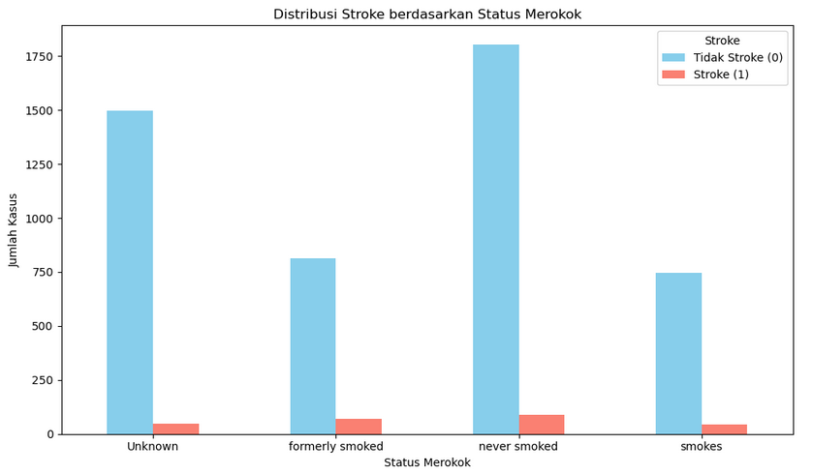

Slide 9
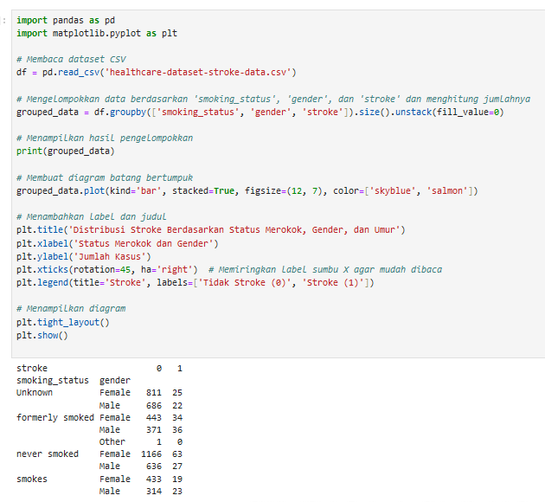
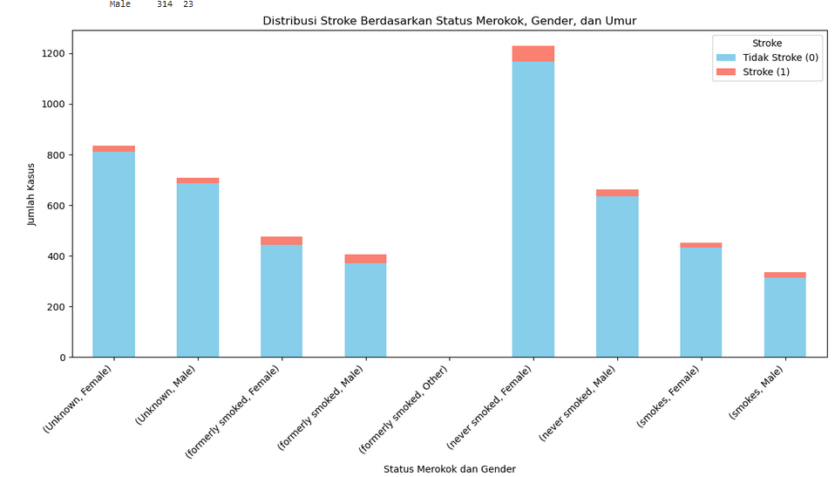

Slide 10
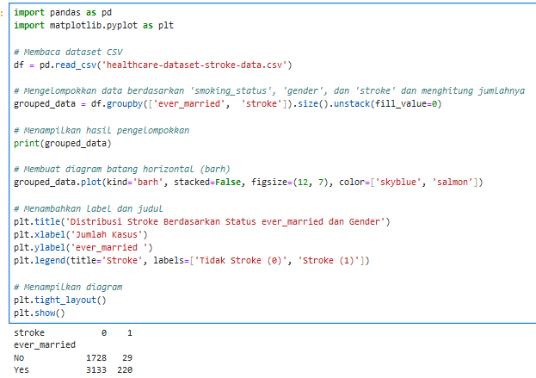
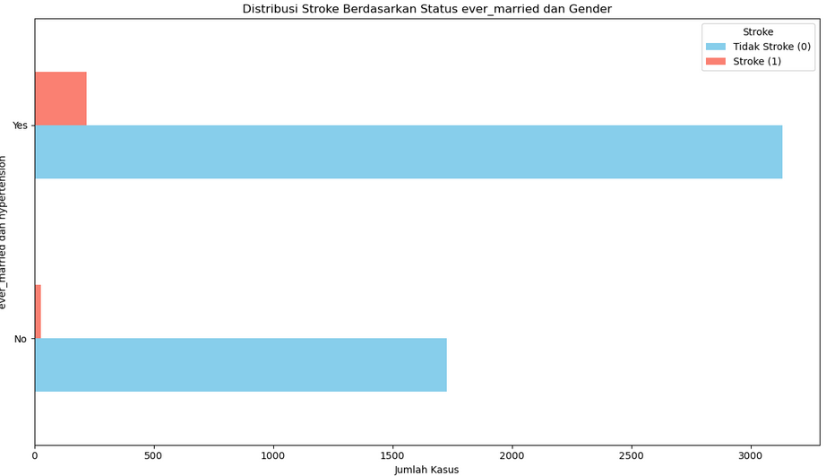

Slide 11
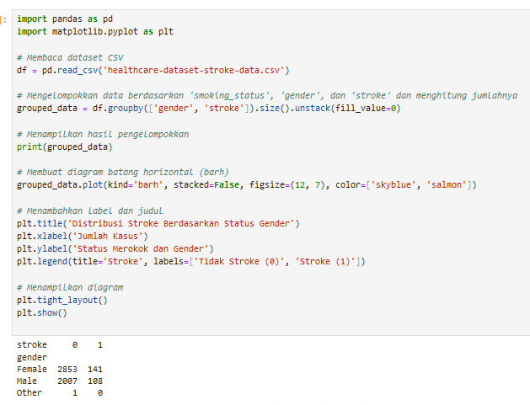
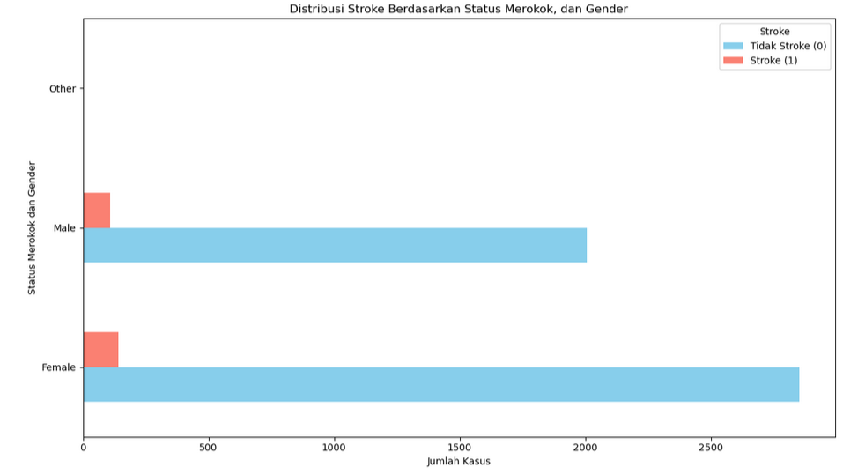

Slide 12
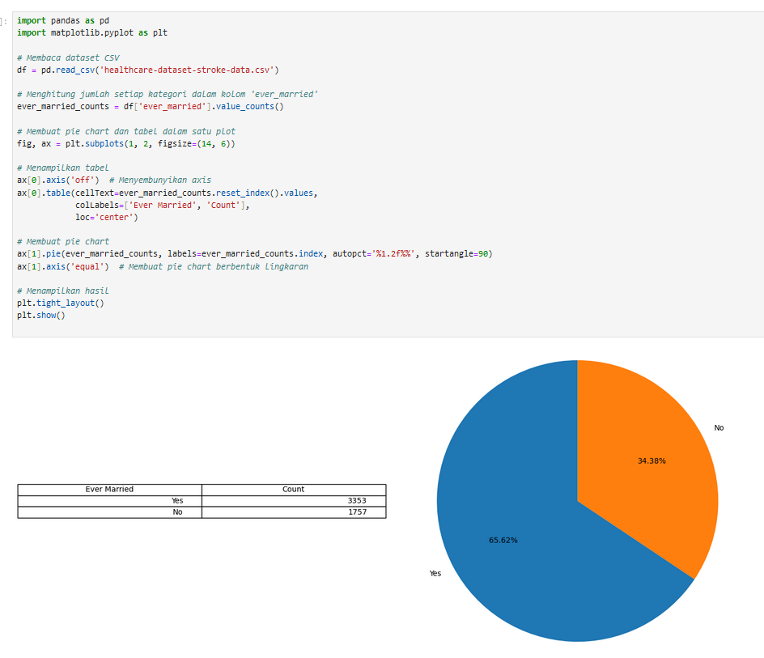
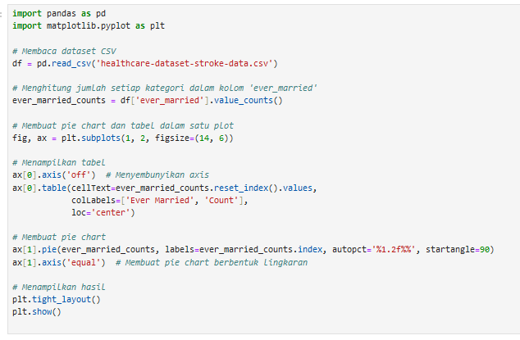

Slide 13
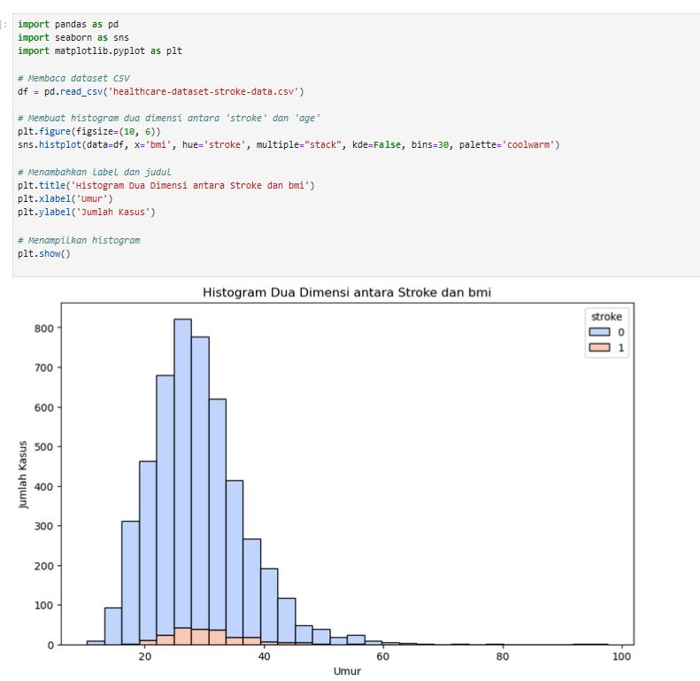

Slide 14
TERIMA KASIH

Slide 15






























Free Resources
Use these free, recolourable icons and illustrations in your
Canva design.

Slide 16

01
Recruitment
Asks
02
Referrals
Write the areas of your company you need help with from your investors. Be specific with your needs.
03
Intros
04
Feedback

